Slide 1


SAP S/4HANA CDS, BTP Full Stack Training Day 3
Anubhav Oberoy

Slide 2

Day 3
VDM – Virtual Data Model
Analytic Use case
S/4HANA Embedded Analytics
--break
Consume CDS in SAC
CDS Security and Steps for securing data
--break
Introduction to SQL Script
AMDP
CDS Table Function
Notes:
https://unsplash.com/photos/CPs2X8JYmS8

Slide 3

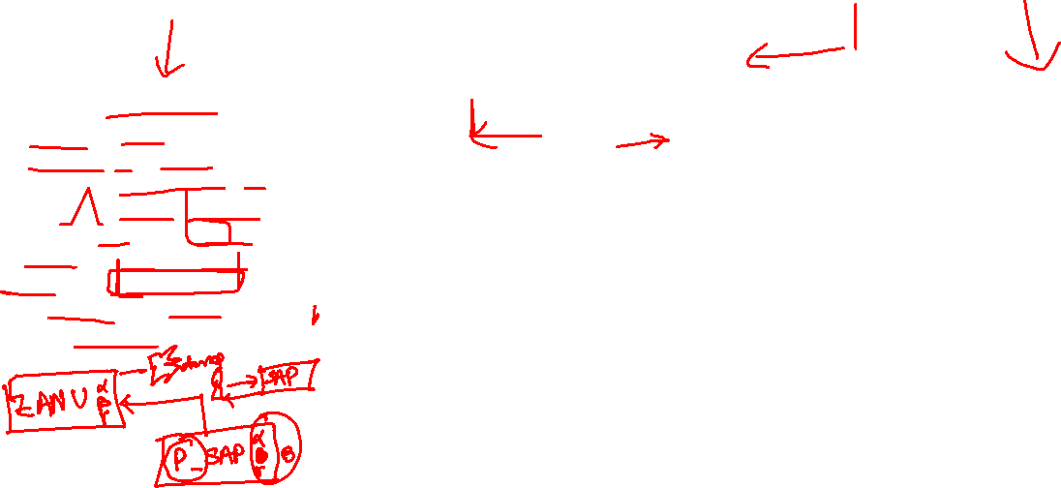

VDM – Virtual data modeling
Is a gold standard and best practice to build CDS views in S/4HANA projects. This standard is adopted already by SAP so by learning this you will also be able to understand standard CDS view structures.
When we join a project, we would not need any KT from anyone if project follow VDM
In absence of a colleague, we will be able to manage the development and understand purpose
When SAP deliver standard CDS views, they do not share mobile no. of their SAP labs developer
It allows great modularization and the best practices for a scalable project design
Interface views
Private
Consumption
Starts with P_
@VDM.private: true
These are the views built by SAP and reused by SAP itself.
As a developer we can use private views to build our views but we must not?
SAP do not guarantee the stable contract
Basic
Composite
Starts with C_, @VDM.viewType : #CONSUMPTION
They are used for final consumption for our use case e.g. Fiori App, Analytics, Integration etc.
Annotations related to final UI and tool consumption
In Data analytics we create with annotation @Analytic.query: true
Which creates a BeX query in SAP S/4HANA.
Starts with I_, @VDM.viewType : #BASIC, #COMPOSITE
We can certainly use them in our projects, view on view because contract remains stable RoR
Basic views are always used to ready either Pure Master or Pure transaction
If we want combination of master and transaction data we can go with composite views
A composite view can act like a #CUBE view for data analytics. Usually these views are used to aggregate data with @DefaultAggregation annotation
We can build interface views on top of private(our) or other interface views
9
www.anubhavtrainings.com

Slide 4
Arrangement
Fiori App
Analytic Tools
Third Party
API Consumer
Consumption views
Consumption views
@Analytic.query
Interface composite views
Interface Composite views
#CUBE
Basic interface views
Basic interface views
Basic interface views
Private views
Private views
DB Tables
DB Tables
DB Tables
DB Tables
DB Tables
DB Tables
DB Tables
9
www.anubhavtrainings.com

Slide 5





Dimension and Measure in Analytics
Master data = Dimension
CID | Name
C1 | SAP
C2 | Apple
C3 | Microsoft
C4 | Oracle
PID | Name
P1 | Laptop
P2 | Phone
P3 | RAM
P4 | WebCam
Transactional Data – Facts
Amount ➔ Measure for performance of sales (numeric)
Aggregation ➔ KPI (key performance indicator)
SOID | CUST | PROD | AMT | CTRY
1 | C1 | P1 | 500 | IN
2 | C1 | P2 | 600 | US
3 | C2 | P1 | 800 | US
4 | C2 | P2 | 850 | IN
5 | C3 | P2 | 1000 | IN
Top Customers
SAP 1100
Apple 1650
MSFT 1000
ORC 0
SUM(sls)
Ctry | Country
IN | India
CN | China
US | United States
JP | Japan
Time

Slide 6
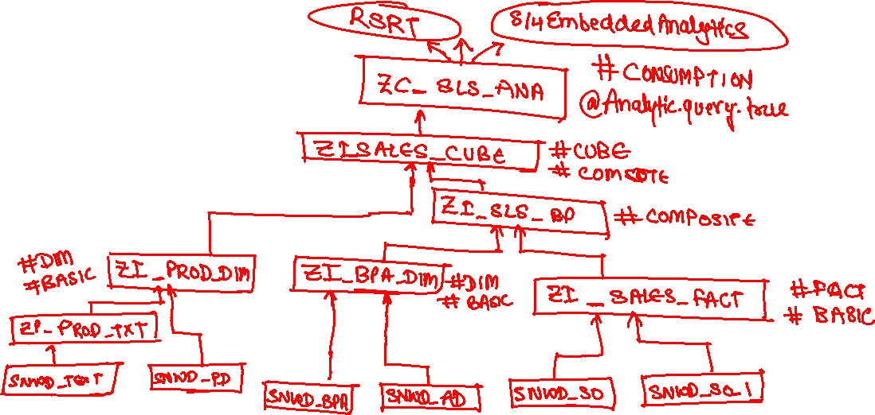

Use Case
We are working as S/4HANA consultant in a company, the company have sales stored in the EPM data table. We would like to build a dashboard to help company projecting following requirement
Total sales per Country – total gross amount, max net amount, average tax amount
Total Sales per Currency
Total Sales per Product
Total Sales per Customer
9
www.anubhavtrainings.com

Slide 7
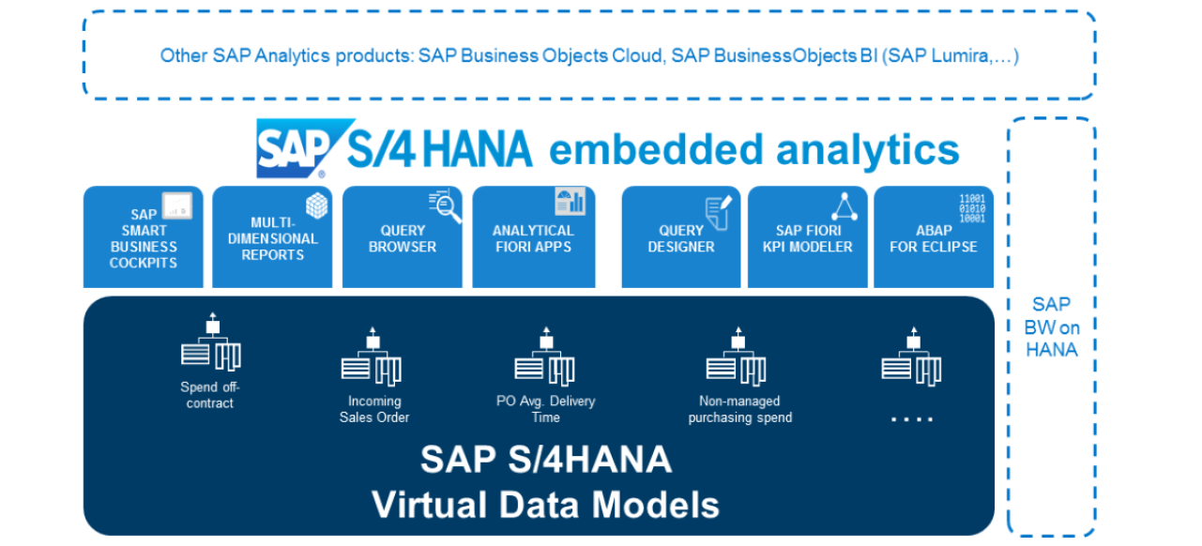
S/4HANA Embedded Analytics
It is a collection of SAP Fiori tiles in SAP S/4HANA that enable real time operational reporting. Embedded Analytics uses SAP Fiori as the front-end user interface and SAP has delivered standard content known as Fiori analytical apps for various functional areas.
SAP S/4HANA Embedded Analytics Scope
Business Innovation through Radical Simplification, Agility and Creativity for the Line of Business, Scale and Trust for the Enterprise, Simplify the Platform, Enhance the user experience, Innovate for the future
9
www.anubhavtrainings.com

Slide 8
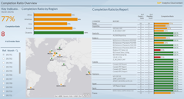
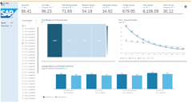
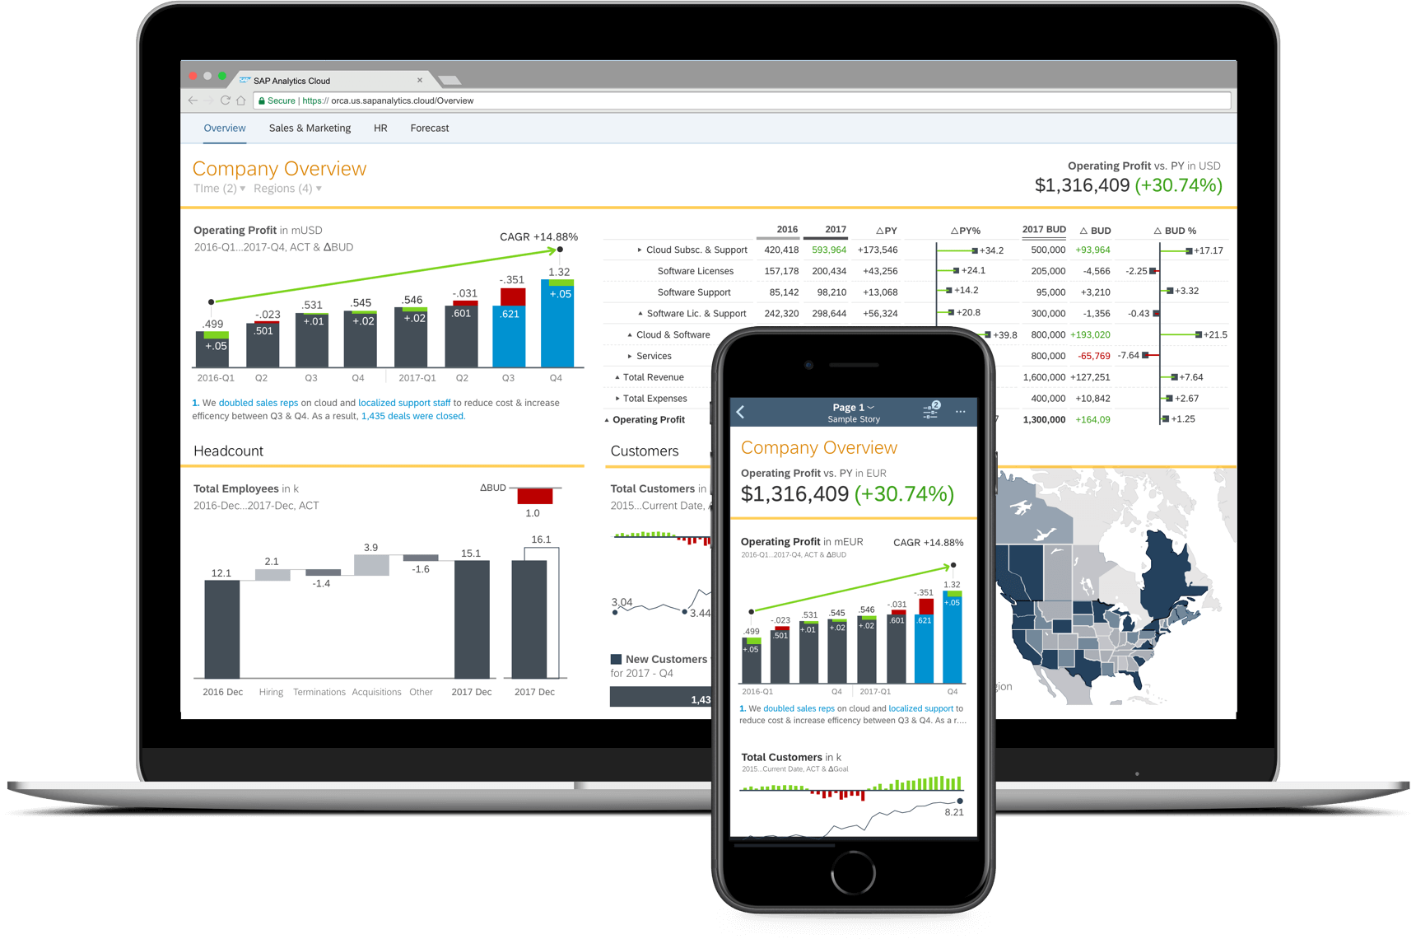

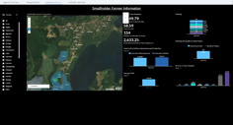
SAP Analytics Cloud Integration with CDS
72 Packages by SAP
SAP S/4HANA
SAP C/4HANA
SAP SFSF
SAP Concur
SAP Ariba
etc..
SAP data sources
Non-SAP data sources
Accelerate your Enterprise Analytics projects with pre-built analytics from SAP and our Partners
9
www.anubhavtrainings.com

Slide 9
Use Case
We have business partner data of multiple counties displayed on the BUPA view. We want to secure this data, we want also row level security. That a manager who is working in US can only see USA customers hence a manager in Japan must only see the Japanese customers.
User
CDS DCL
Auth Class
1..*
Role
Auth Objects
Profile
1..*
Auth Fields
value
9
www.anubhavtrainings.com

Slide 10
Steps
Transaction code SU20 and define an authority field since we want to control permissions based on Country we will use the field as Country. - ZCTRY_APR
Go to transaction SU21 and create a authority class (ZBUP) and authorization object (ZAPR_BUPA).
We add the authority field to the object and a new filed ACTVT with type as 03
Open tcode pfcg and create a new role - ZAPR_BR_CDS_BUPA
9
www.anubhavtrainings.com

Slide 11

SQL Script
SQL Script is a collection of extensions to SQL (DML, SQL, DCL) in HANA. It is DB programming language. It adds procedural capabilities (programming – if, loop, else, conditions, logical, mathematical) to the SQL.
It allows developers to write Data intensive logic (like ABAP) inside HANA DB directly so achieve best in class performance from HANA. This is the perfect the ultimate way to achieve code-to-data paradigm.
When to use?
When we have no other way to improve performance of our scenario, we will use SQL Script.
https://help.sap.com/docs/SAP_HANA_PLATFORM
https://help.sap.com/docs/SAP_HANA_PLATFORM/de2486ee947e43e684d39702027f8a94/28f2d64d4fab4e789ee0070be418419d.html
www.anubhavtrainings.com

Slide 12
Types of SQL Script
Statements
Data Flow graph
Declarative Logic
Imperative Logic
Orchestration logic
Gets converted to a data flow by hana
There is a strong chance of this type of logic being processed by HANA in parallel
www.anubhavtrainings.com

Slide 13
Data Flow Graph
End
--Q1
Lt_products = select * from products where category = ‘PC’;
--Q2
Lt_sales = select * from sales where pid = (Select prodid from lt_products)
--Q3
Lt_purch = select * from purchases where pid = (Select prodid from lt_products)
--Q4
Lt_total = select sum(gross) from lt_sales;
What will kick-out from parallel mode
Local and scalar variable which are in use, it will kick us out of parallel mode DELCARE
Inside a processing block if we execute any DML or DDL statement
Encounter any imperative logic (IF, Looping, Cursor)
SQL statements which are not assigned to implicit variables
Rules which will help to run max. time in parallel mode
Split the code over multiple containers where we feel we need to run imperative logic
Keep all the logic at the end which expect us to kick out from parallel mode
Q4
Q2
Q3
Q1
Start
www.anubhavtrainings.com

Slide 14
Data types in SQL Script
Data Types
Scalar
Array
Table
Declare var datatype ARRAY;
Declare statement
Declare var datatype;
Datatypes
Numeric – TINYINT, INT, SMALLINT, BIGINT, DECIMAL, DOUBLE
Char – CHAR, VARCHAR, NVARCHAR
Date – DATE, TIMESTAMP
Binary – VARBINARY
Long – CLOB, BLOB
implicit
explicit
www.anubhavtrainings.com

Slide 15
Rules of the Game
SQL Script is not case-sensitive
Every statement must end with semi-column ;
When we create a variable and assign value to it we use variable name itself but when we use that variable we use a value of operator colon(:)
Declare x integer;
Declare y integer;
X := 10; y := :x + 10;
If we create variable and do not assign initial value to it, a NULL gets assigned and any operation with NULL becomes NULL
In SQL Script the = is a comparison operator but := is assignment operator.
Anything in SQL Script evolve around SQL.
www.anubhavtrainings.com

Slide 16
ABAP Managed Data Procedure
ABAP – Dev
ABAP – QLT
AMDP
AMDP
HTC
Top Down approach
Top Down approach
HANA - Dev
HANA – QLT
Procedure
Procedure
www.anubhavtrainings.com

Slide 17


AMDP – ABAP managed data procedure
AMDP is a SQL Script container in ABAP system, It is technically a static function in an ABAP class which contains SQL Script code.
We will add a marker interface to abap class. Its ready to support syntax check as well as code for Sql script.
Rule – Big power comes with big responsibilities
AMDP function can only have importing and exporting params. All the parameters must be pass by value
We cannot use the deep nested types
Only SQL Script is supported. Only HANA is supported to create AMDP
If we want to use ABAP tables inside procedure must specify table names with using clause
No ABAP functions, statements are allowed, CANNOT merge ABAP code inside SQL Script code
The procedure in HANA is created when you call the AMDP first time, in ABAP schema
In HANA multiple procedures will gets created for version management
AMDP – SQL Script
Normal ABAP Class
Mutation
If_amdp_marker_hdb
www.anubhavtrainings.com

Slide 18

OIA Scenario – Based on EPM Model
Open Item Analysis Scenario
Mr. Jems is 65-year-old men, working in ITeIO company since last 25 years as an account receivable accountant. He drives Audi A8 and lives in downtown in his own house near the lake. He loves reading books and do gardening.
Who is an Account Receivable Accountant?
Cash has a very important role for the success of the business. It is in the best interest of a company to collect the pending dues from their customers on time. By putting this cash back into the system company can execute their expansion plans and perform better for profitability in the future. An accountant’s job is to look into the system and find out all the unpaid invoices. He typically comes into the office and look for invoices are pending since long time and exceeds a particular threshold. Classify these invoices and perform dunning (contact customers).
9
www.anubhavtrainings.com

Slide 19
Takt Plan
Store the threshold levels inside a customizing table for the user – ZDP_CUST
How long the invoices are due on average days basis
Invoices which are unpaid by the customers – SNWD_SO_INV_HEAD where Payment_status = ‘’
Calculate the average no. of days since when every invoice is pending for each customer (Today – When was changed)
We will calculate average = Total (How many days all invoices are due) / Count (Count of invoices)
e.g. total 4 invoices due as 10,20,30,5 = 10+20+30+5 / 4
Join this with the customer master SNWD_BPA
3. Calculate the total due amount in common currency
1. Find the open invoices which are due SNWD_SO_INV_HEAD , Payment_Status = ‘’
2. get the items for each due invoice and its amount with currency code – SNWD_SO_INV_ITEM, CONVER_TO_CURRENCY
3. Convert the amount to a common currency which we can read from the Customizing table
4. Total due amount and join with Customer Data
4. Compare the open days and open amount with the threshold, if yes, we will tag the customer.
Takt1
Takt2
9
www.anubhavtrainings.com

Slide 20
Questions
How to debug an AMDP
https://www.youtube.com/watch?v=h09XRxhpNXI&list=PLcxqFaocb9WLtnq-rpXbRy5hnKECxr95G&index=69
https://www.youtube.com/watch?v=fpXoTqHLeSo&list=PLcxqFaocb9WLtnq-rpXbRy5hnKECxr95G&index=70
Can I pass select option to AMDP
https://youtu.be/hbtnWi032Z8
Can I call another AMDP inside my AMDP
https://youtu.be/Tm1RFOt0KMY?list=PLcxqFaocb9WLtnq-rpXbRy5hnKECxr95G
https://youtu.be/r2LsDROiJ90?list=PLcxqFaocb9WLtnq-rpXbRy5hnKECxr95G
https://youtu.be/dIMPMNlT7jQ?list=PLcxqFaocb9WLtnq-rpXbRy5hnKECxr95G
Can I see another practical AMDP scenario other than OIA, ABAP equivalent of FOR ALL ENTRIES
https://youtu.be/1JkX-XuSeVE?list=PLcxqFaocb9WLtnq-rpXbRy5hnKECxr95G
How to do performance analysis of an AMDP
https://youtu.be/KLgTI1J5d3E
www.anubhavtrainings.com

Slide 21
Title
When to create CDS v/s AMDP
If you are on HANA and CDS is not enough for performance then only you should go amdp
Limitations/Drawbacks of AMDP
You need to do client handling yourself
You will lose LUW benefit for update scenario
Not have data locking concept
Debugging is sometime hard to trace runtime issues generic cx_amdp_error
9
www.anubhavtrainings.com

Slide 22

Questions?

Slide 23


Thank you
Anubhav.abap@gmail.com
contact@anubhavtrainings.com
+91 84484 54549
www.anubhavtrainings.com

